Slide 1
Engines

Slide 2
Engines are used to transfer heat from cold areas to hot areas.
External combustion engines use superheated steam to drive a piston. This video shows how they work.

Slide 3
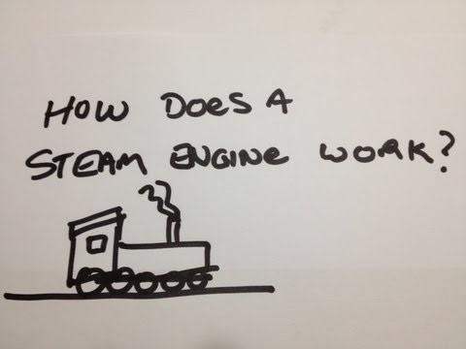

Slide 4
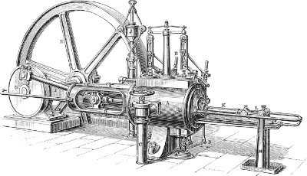
Pistons sit inside a piston cylinder, which allows them to move back and forwards. Water is superheated outside the piston cylinder, producing steam.
The expanding steam pushes down on the piston, pushing it in. The steam is then removed from around the piston chamber, which allows the piston to move back out. This piston movement is used to generate work, allowing the engine to power things such as cars and trains.
The steam is condensed, reheated, and recycled, allowing the cycle to repeat.

Slide 5
All modern cars use internal combustion engines. These engines convert the chemical energy which is stored in fuel into motion.

Slide 6
